Slide 1
Intro to ML + Recap
Freshers Introductory Meet for ML/AI
@ SSN Coding Club

Slide 2

What we will be covering..
What machine learning is..
A timeline of events for the ML domain of this club.
How to get started learning ML as a fresher.
A quick recap of the first 2 meets.
Scan to ask questions anonymously in Slido or ask away in the Teams chat!

Slide 3
Timeline of
Events
Intro to ML - Scope, Roadmap and a simple analysis of a dataset - Done
Building a simple ML pipeline from scratch in Python - Linear Regression - Done
Freshers Intro + Recap Meet - Now
Building a binary classifier - Logistic Regression - In 1 to 2 weeks
Beginners Contest - based on what we have covered till now - Sometime in Jan
Recording Links, Code and Resources
for both Meet 1 and 2:
github.com/ssncodingclub/Machine-Learning

Slide 4
What is Machine Learning?
Machine learning allows computers to make intelligent decisions (i.e: predictions) by observing real-world data, without the need for explicit programming / hard coding of the decision logic.
Many ML models derive from ideas in statistics that have existed for a long time. Hence, knowledge of fundamental statistics is a requirement before getting started with ML.
To get started, knowledge of 12th grade math (linear algebra, probability distributions and stats) and basic Python (understanding functions, loops, arrays, classes, installing packages) should do.
The README file here has a checklist-style roadmap to get started with ML:
github.com/ssncodingclub/Machine-Learning

Slide 5
Upcoming sessions
Tentatively, the upcoming sessions will focus on:
Teaching core ML concepts
Building simple ML models
Understanding how to analyse and improve their performance, why deep learning is needed
The current state of ML research and how ML models are deployed.

Slide 6
Areas where ML is useful
Computer Vision / Image Processing
Speech Recognition
Traffic prediction
Product recommendations
Email Spam and Malware Filtering
Online Fraud Detection
Stock Market trading
Automatic Language Translation (NLP)

Slide 7
Types of ML

Slide 8


Slide 9
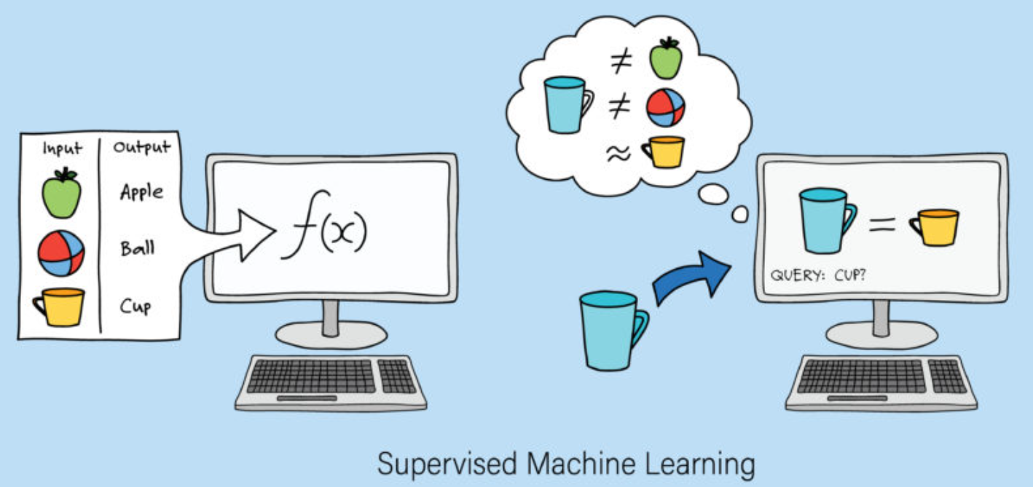
Supervised Learning
Learning a function that maps an input to an output based on example labelled input-output pairs.
It is used in the context of two types of problems typically:
Classification
Regression

Slide 10
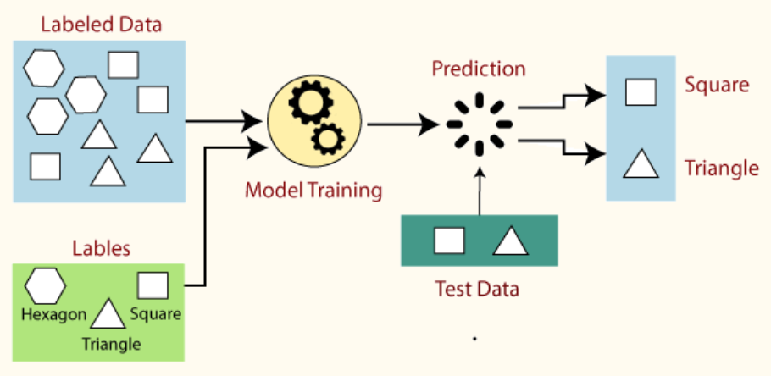
Classification
Uses a learning algorithm to learn a function that maps the input data to one of the output classes or categories.

Slide 11
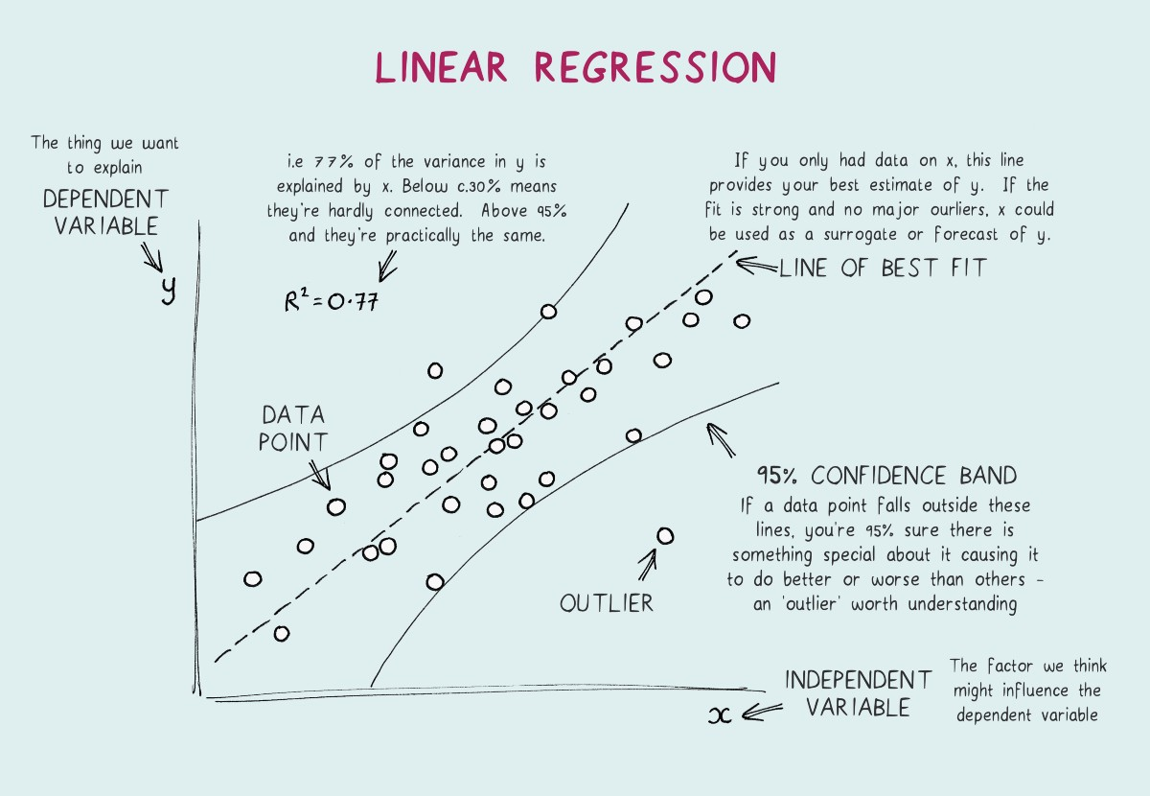
B. Regression
Learns the relationship between dependent and independent variables.
(You will learn to implement 2 fundamental regression techniques from scratch using Python in this session!)

Slide 12
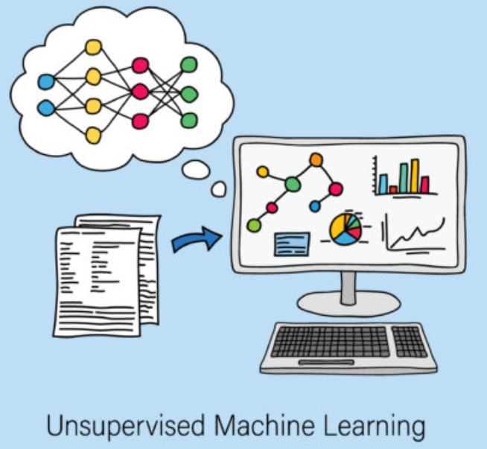
2. Unsupervised Learning
The data is not labelled
Self-discover any patterns in the training data set
It is used in the context of two types of problems typically-
Clustering
Dimensionality Reduction

Slide 13
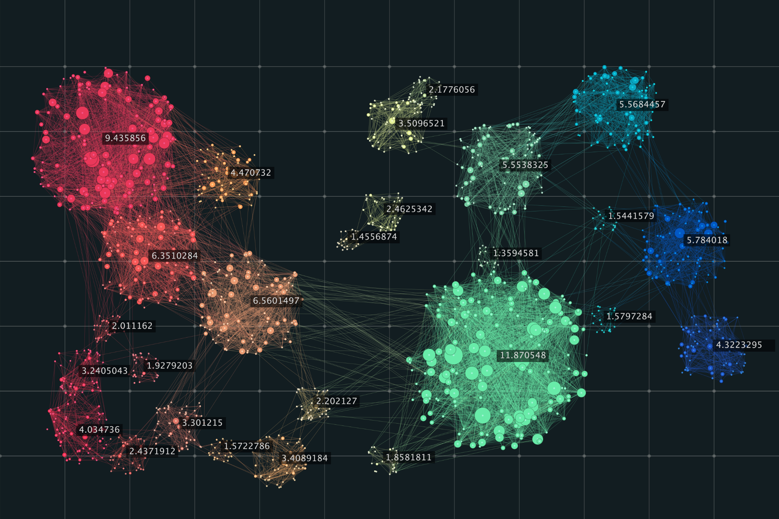
Clustering
Clusters training examples into categories with similar features using various metrics

Slide 14
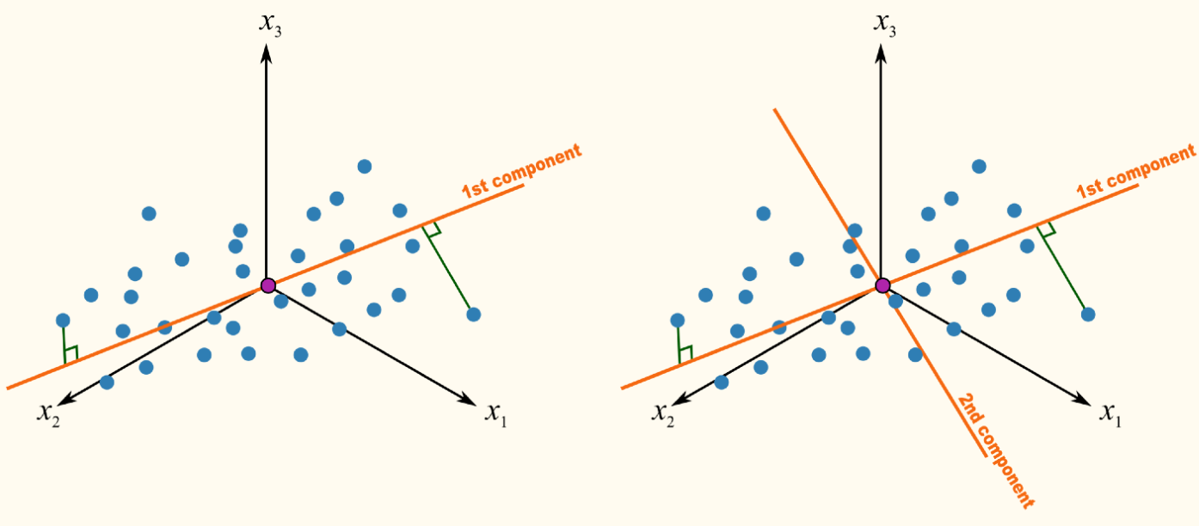
B. Dimensionality Reduction - Principal Component Analysis
Finds ways to compress the training data set by identifying which features are most useful for discriminating between different training examples, and discarding the rest.

Slide 15
Supervised Learning
Trained using labeled data, essentially learns a mapping function from inputs to outputs
Could take direct feedback
Requires labelled data (usually done manually) which is sufficiently pre-processed.
Unsupervised Learning
Trained using unlabeled data, discovers patterns within the data to extract information
Doesn’t take any feedback
Lesser preprocessing of data but coming at the cost of larger training data, slower convergence to results, increased computational and storage requirements, etc.

Slide 16
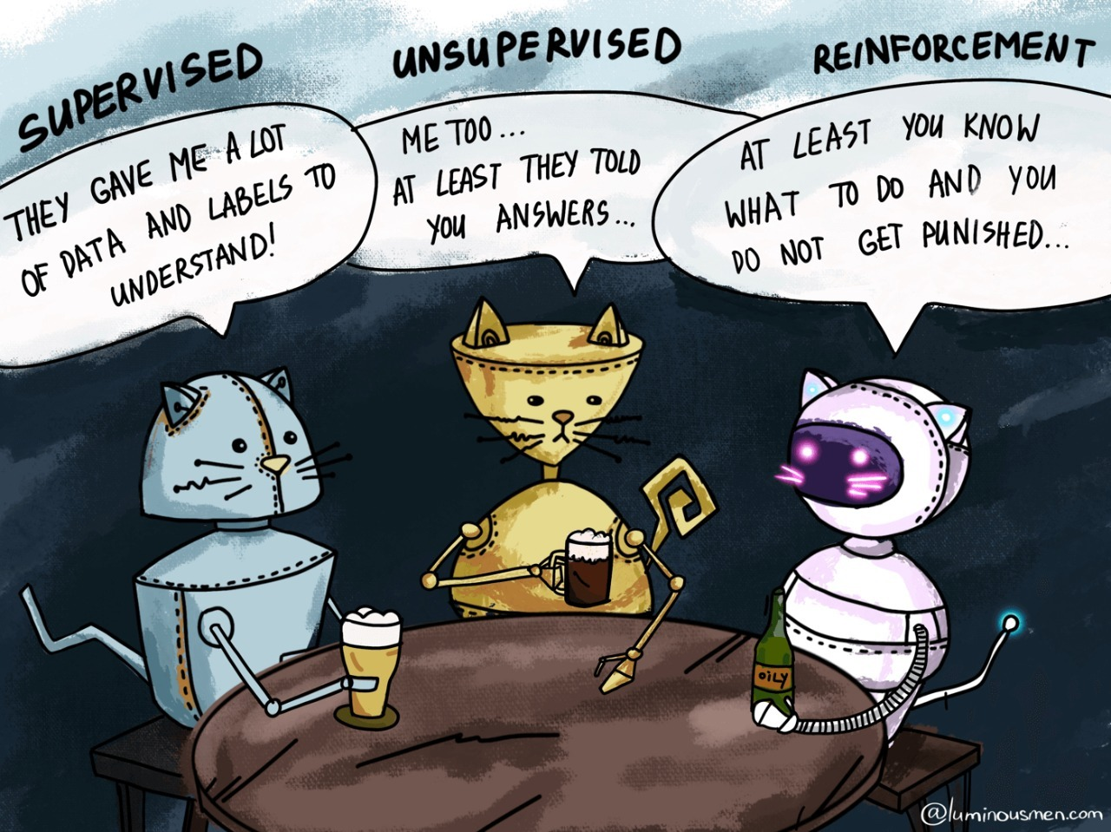

Slide 17

General building blocks of any ML pipeline

Slide 18
Fundamentals in ML:
Every ML (and even DL) model share in common a few fundamental concepts.
Model - A function that maps the input to our expected output: y = f(x), it’s characterised by a set of parameters (or weights) that our algorithm has to learn (eg: y = w1.x + w2)
Train and Validation Data: The entire dataset of (x, y) pairs is split in a 80-20 fashion, 80% is used for training the model and 20% is used to validate if the performance is good.
Loss Function: Given a set of weights and a dataset, it gives a number that says how close the models predictions are to the expected y values. (the lower, the better)
Optimizer: An algorithm that tweaks the weights of the model so as to minimise the loss
Metrics: Other metrics like accuracy that can also be used to judge how a model is doing, in addition to the loss function.

Slide 19
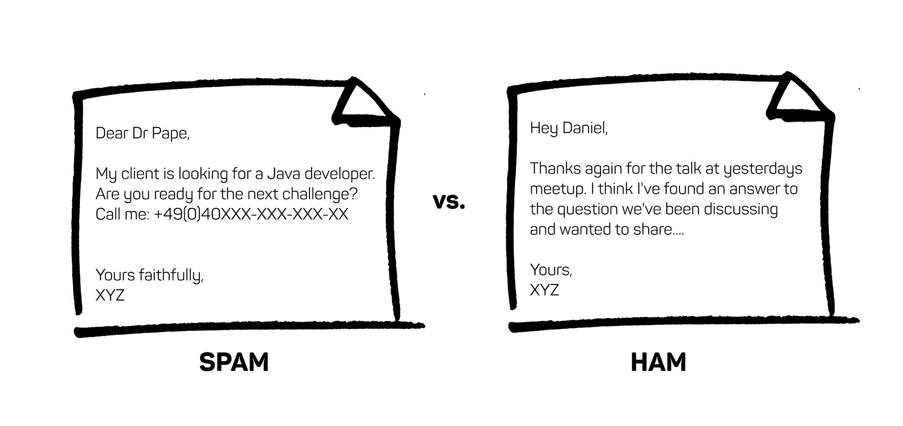
Examples:
You’re given a dataset of emails, with each email labeled as spam or non-spam.

Slide 20
Examples:
You’re given a dataset of emails, with each email labeled as spam or non-spam.
Supervised or unsupervised?

Slide 21
Examples:
You’re given a dataset of emails, with each email labeled as spam or non-spam.
Supervised or unsupervised?
Classification or a regression problem?

Slide 22
Examples:
You’re given a dataset of emails, with each email labeled as spam or non-spam.
Supervised or unsupervised?
Classification or a regression problem?
What metric would you use to get a general idea of how the classifier is doing?

Slide 23
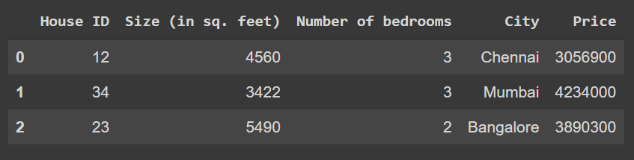
Linear Regression
Consider a problem where you want to predict the prices of different houses, given some information about them.
So the price (target variable we wish to predict) can be modeled as a linear function of size and number of bedrooms. (is house ID relevant?)
Source: ML Meet 2 Notebook

Slide 24
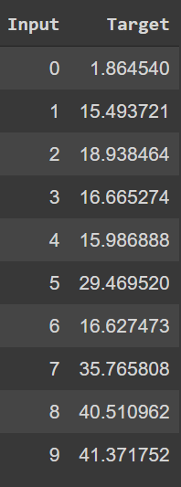
Linear Regression
Consider a simpler version of this problem, where the target variable ‘y’ only depends on one input variable ‘x’.
Thus, a linear regression model would be: y = mx + c, where m and c are the slope and y-intercepts respectively.
Now, given a list of such (x, y) pairs (the dataset), linear regression aims to find the m and c values that fit the data the best.

Slide 25
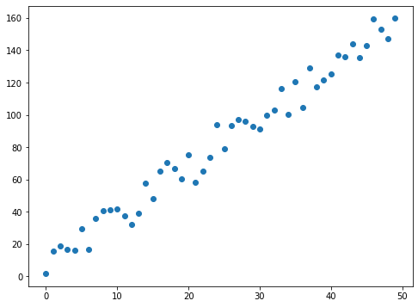
Linear Regression
This shows the various (x, y) pairs plotted as a graph.
Clearly, x and y have a linear relationship but they don’t follow an exact straight line.
But we can fit a straight line to this data.
Why would we do this? Once we do this, the y values for any other x values can be easily calculated for future predictions.

Slide 26
Linear Regression
Each ‘fit’ is basically one configuration of the m and c values.
Visually, the red line here is a bad fit, the blue line is relatively better and the green line is a good fit.
What makes one fit better than another mathematically?
We decide how good a fit (or a model configuration) is by looking at the loss function value.
Lower the training loss, better the fit on the training data.
The most common loss function for regression is Mean Squared Error.

Slide 27
Linear Regression
How do we make the computer get the best fit automatically?
We start off with a random m and c value, then we iteratively improve it (change it so the loss gets lower and lower as time goes on)
How do we know what optimal change to make that reduces the loss the most?
This is where optimizers come in, they take a model and a dataset and tweak the model so as to minimize the given loss function.
The most well known (family of) optimizers in ML is Gradient Descent.

Slide 28
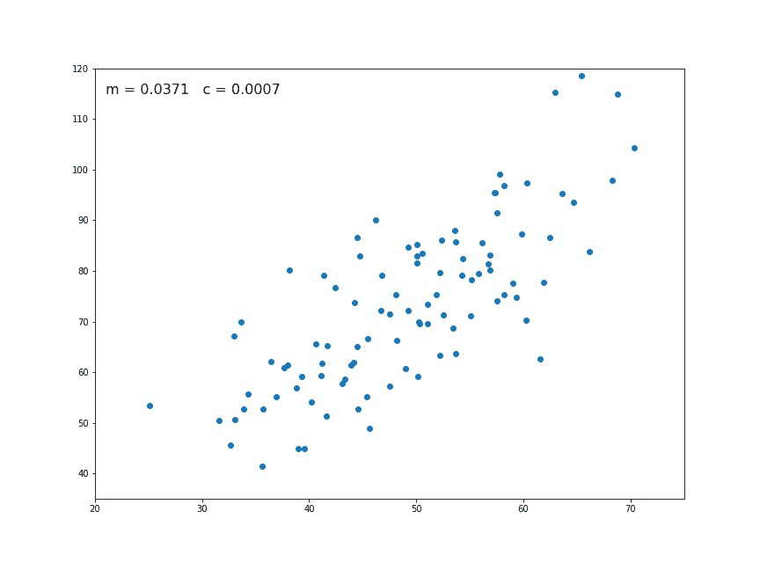
Linear Regression

